Slide 1
BENCHMARK TEST OF DIFFERENT DATA STRUCTURES
BY:- Arjun (16IT108)
Tarun (16IT143)
Sulabh (16IT245)
Uttam (16IT250)

Slide 2
A V L TREE

Slide 3
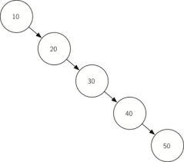
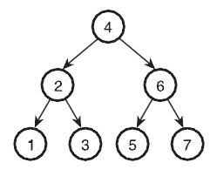
Binary Search Tree - (BST)
All BST operations are O(h), where h is tree Height
So, best case running time of BST operations is O(log N),N is no of nodes
Worst Case Runtime is O(N)
Level 1
Level - 0
Level 2
Level 3
Level - 1
Level - 4
Level - 3
Level - 5

Slide 4
AVL TREE
(ADELSON-VELSKY LANDIS TREE)
AVL tree is a self-balancing binary search tree.
In an AVL tree, the heights of the two child subtrees
of any node differ by at most one
At any time they differ by more than one,
rebalancing is done to restore this property
The AVL tree is named after its two Soviet inventors,
Georgy Adelson-Velsky and Evgenii Landis

Slide 5
INSERTION IN AVL TREE
AVL trees are height-balanced
So we need to check for unbalance and rebalance it
after every insertion
We follow different types of rotation in order to make
a balanced AVL tree
This is what an AVL tree has in addition to BST,and
helps in reducing the searching time of an element

Slide 6
ROTATION IN AVL TREE
It is observed that BST's worst-case performance is closest to linear search algorithms, that is Ο(n).In real-time data, we cannot predict data pattern and their frequencies. So, a need arises to balance out the existing BST.
To balance itself, an AVL tree may perform the
following four kinds of rotations −
1.) Left rotation
2.) Right rotation
3.) Left-Right rotation
4.) Right-Left rotation

Slide 7
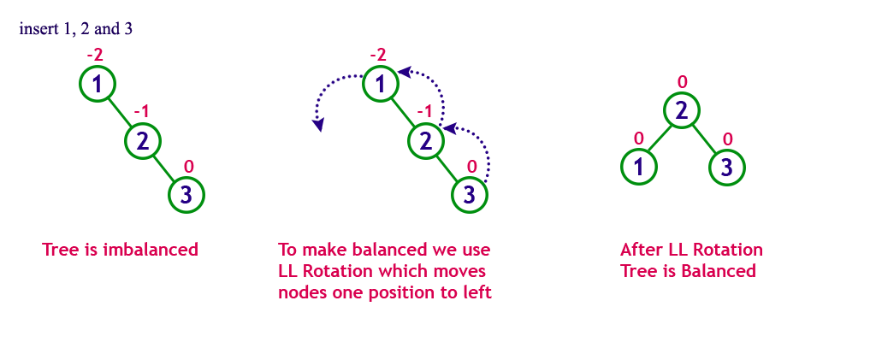
LEFT ROTATION

Slide 8
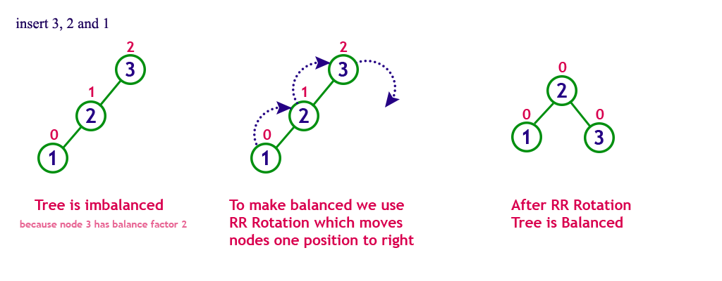
RIGHT ROTATION

Slide 9
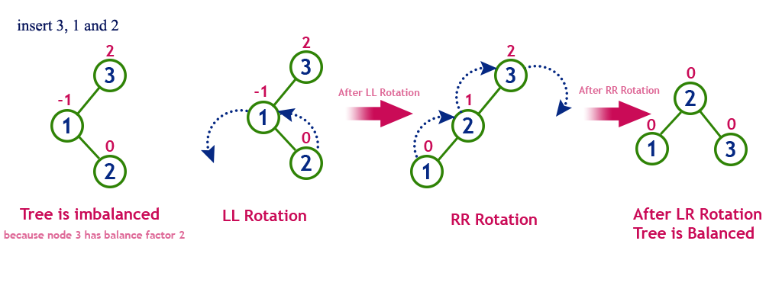
LEFT – RIGHT ROTATION

Slide 10
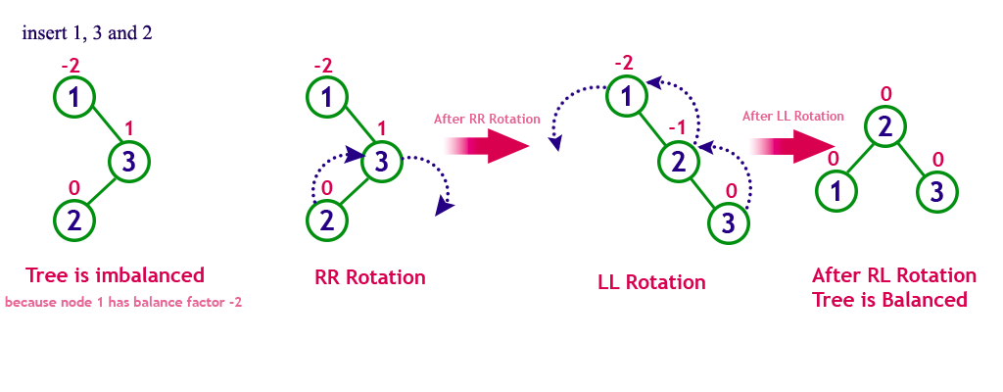
RIGHT – LEFT ROTATION

Slide 11
INSERTION ANALYSIS Of AVL TREE
For a tree structure in which insertion and deletion
operations are frequently -performed, it is important
to know the costs of performing those operations as
well as the cost of locating a node in the tree.
worst case of insertion can take as many as 0(N)
steps.
Our Benchmarks on AVL tree data structure shows
the validity of the above statement

Slide 12
DATA USED :
Number Of Inputs | Time ( in seconds )
100 | 0.08615279346503
500 | 0.55996036736043
1000 | 1.42340869934858
2000 | 2.76904822010653
10000 | 66.2678865397173
20000 | 262.363124578518
35000 | 1083.36185326836
50000 | 2139.84110795983
100000 | 8075.95028181761

Slide 13
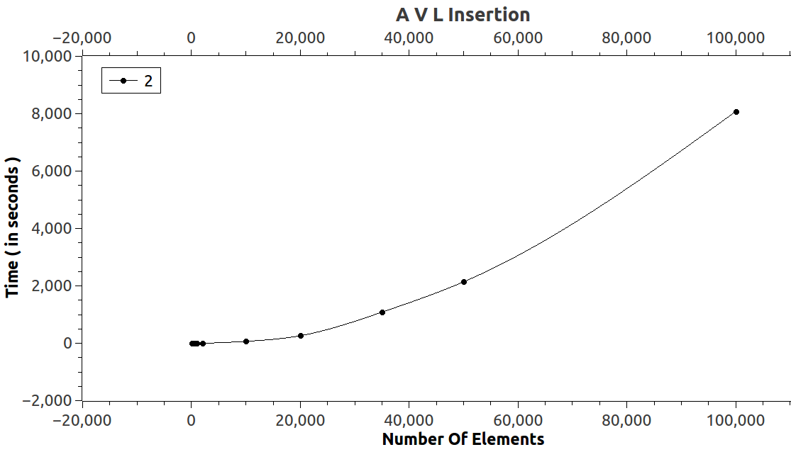
Graph Obtained :

Slide 14
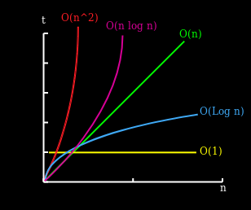
OBSERVATION:
Since in the Worst case Time complexity of AVL
insertion is O(log n) , and our graph approximately is
equivalent to a graph representing log n function.
Plot for o(log n)
Since our benchmark test was done
on a regular use PC,it might not get us
an accurate result.

Slide 15
SEARCH ANALYSIS Of AVL TREE
Since the worst case for an element to occur in an
AVL tree should be the last level of the tree.
Hence the time taken to search for an element in
Worst case should be O(d).where d is the depth of the
tree.
So the Worst time complexity for search will be
O(log n).As depth of an AVL tree is given as d = log n
Where n is number of nodes.

Slide 16
DATA USED :
Number Of Inputs | Time ( in seconds )
100 | 0.0017232613016453
500 | 0.0057611920132645
1000 | 0.0010263715868110
2000 | 0.0009773838744306
10000 | 0.0008960010619318
20000 | 0.0009414332145070
50000 | 0.0005661241275447
100000 | 0.0014486930740531

Slide 17
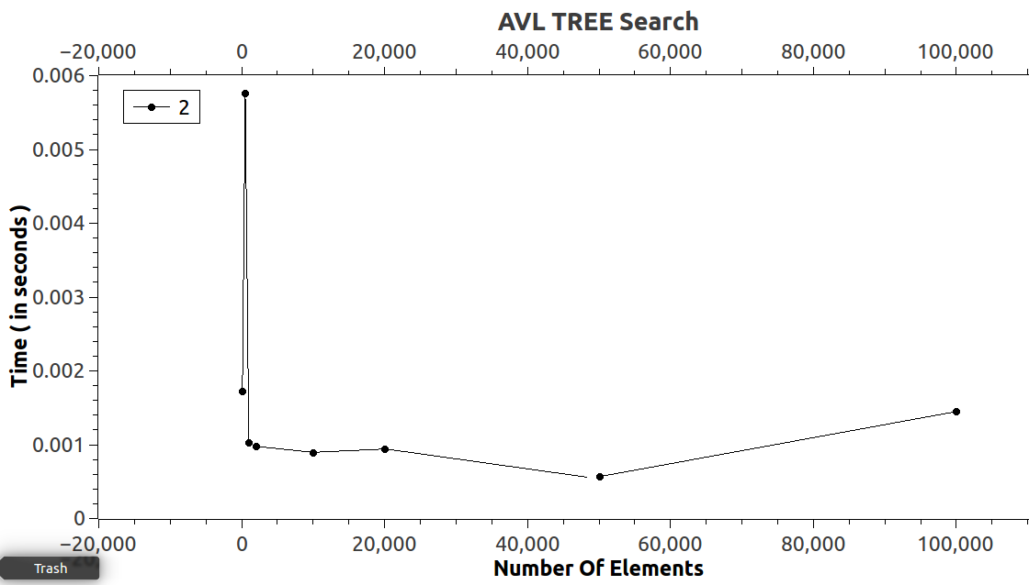
Graph Obtained :

Slide 18
OBSERVATION:
Since in the Worst case Time complexity of AVL
search is O(log n) , and our graph approximately is
equivalent to a graph representing log n function.
Plot for o(log n)
Since our benchmark test was done
on a regular use PC,it might not get us
an accurate result.

Slide 19
DELETION ANALYSIS Of AVL TREE
To make sure that the given tree remains AVL after
every deletion, we must augment the standard BST
delete operation to perform some re-balancing.
Hence deletion requires, spotting the node and
removing it from the tree and then perform an AVL
Rotation.
So, the worst case time complexity for deletion is also in the order of O(log n).

Slide 20
DATA USED :
Number Of Inputs | Time ( in seconds )
100 | 0.0003053830779826
500 | 0.0010848407919095
1000 | 0.0015482487485418
2000 | 0.0030020776320922
10000 | 0.0158530558258434
20000 | 0.0376221680460275
50000 | 0.110554995225811
100000 | 0.22192658401218

Slide 21
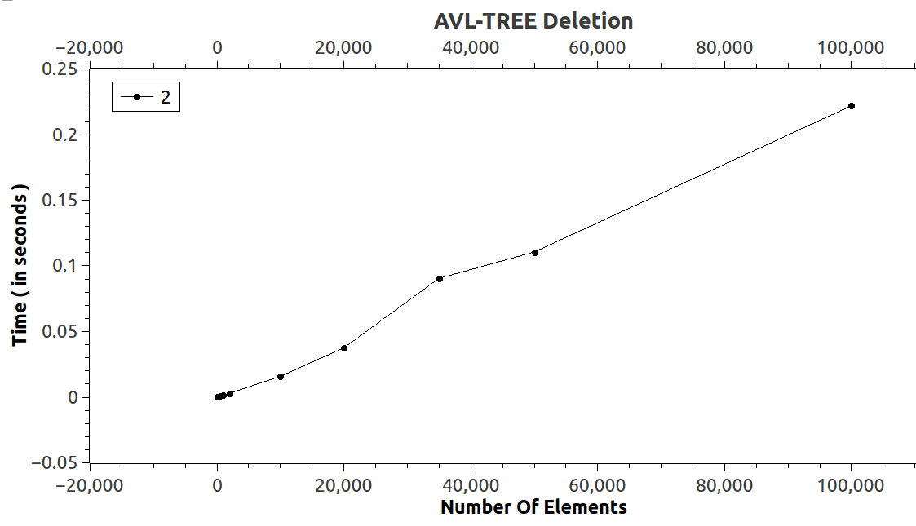
Graph Obtained :

Slide 22
OBSERVATION:
Since in the Worst case Time complexity of AVL
Deletion O(log n) , and our graph approximately is
equivalent to a graph representing log n function.
Plot for o(log n)
Since our benchmark test was done
on a regular use PC,it might not get us
an accurate result.

Slide 23
HEAPS

Slide 24
HEAPS
Heap is a special case of balanced binary tree
data structure.
value of parent is greater than that
of child, this property generates Max Heap
value of parent is greater than that
of child, this property generates Min Heap

Slide 25
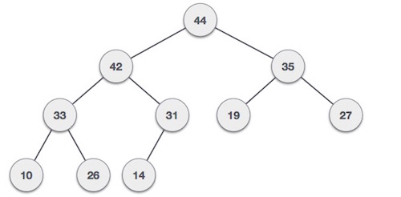
MAX - HEAP
value of the root node is greater than or equal to either of its children.

Slide 26
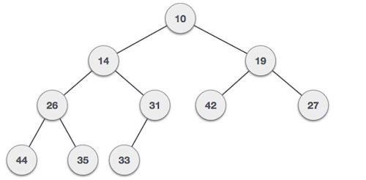
MIN - HEAP
value of the root node is less than or equal to either of its children.

Slide 27
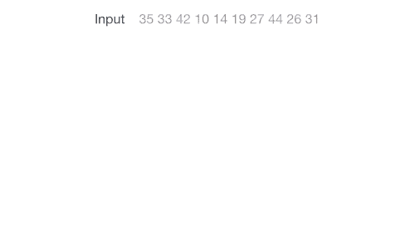
INSERTION IN HEAP
In MIN Heap construction algorithm, we expect the
value of the parent node to be less than that of the
child node, and in MAX Heap parent node to be
Greater.

Slide 28
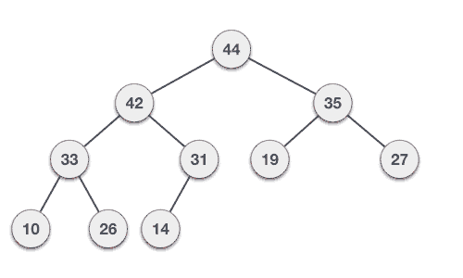
DELETION IN HEAP

Slide 29
INSERTION ANALYSIS Of HEAPS
In the worst case time taken for insertion could be
O(n).
Since after every insertion HEAPIFY is to be done.
Inserting an element would take O(n) time.
As in the worst case heapify wil occur until the last
inserted element goes to the first level,
we would have to traverse n number of nodes.

Slide 30
DATA USED : MAX - HEAP
Number Of Inputs | Time ( in seconds )
100 | 0.0676761295914622
500 | 0.393255972253991
1000 | 0.675290874418814
2000 | 0.160249473875919
10000 | 0.851159132237983
20000 | 1.6421743907252
50000 | 4.1585582126122
100000 | 8.28201159349522

Slide 31
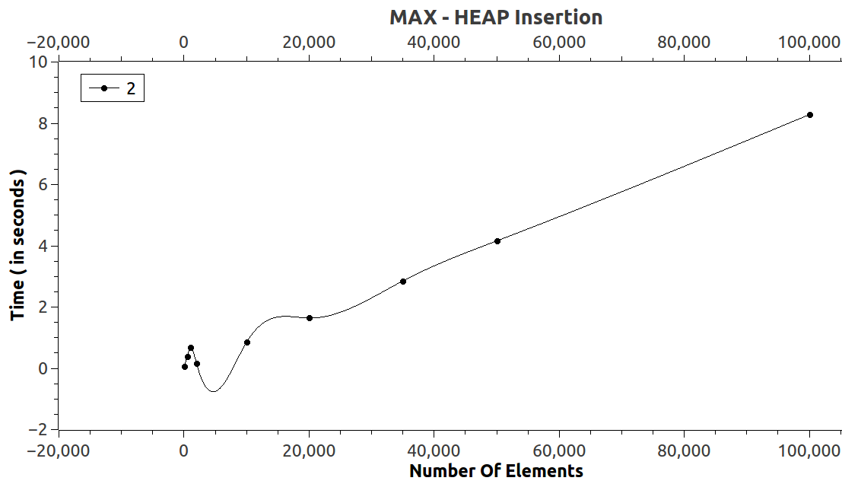
Graph Obtained :MAX - HEAP

Slide 32
OBSERVATION:
Since in the Worst case Time complexity of MAX
HEAP Insertion O(n) , and our graph approximately is
equivalent to a graph representing n function.
Plot for o(n)
Since our benchmark test was done
on a regular use PC,it might not get us
an accurate result.

Slide 33
DATA USED : MIN - HEAP
Number Of Inputs | Time ( in seconds )
100 | 0.0463883876800537
500 | 0.376096725463867
1000 | 0.593802213668823
2000 | 0.155794382095336
10000 | 0.796371221542358
20000 | 1.71893620491027
50000 | 4.19115996360778
100000 | 8.28004693984985

Slide 34
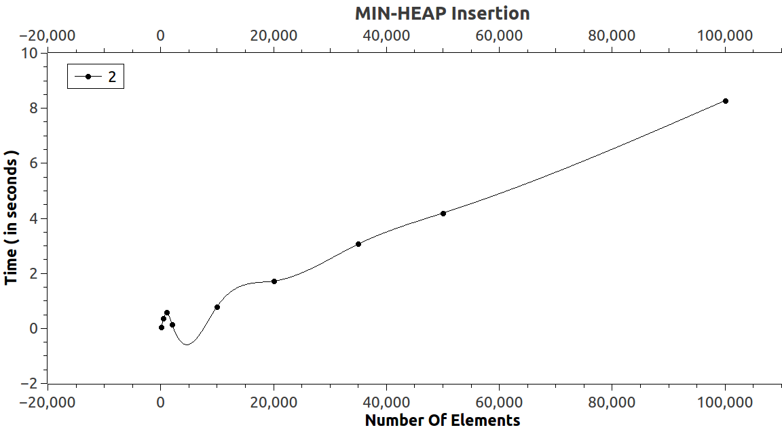
Graph Obtained :MIN - HEAP

Slide 35
OBSERVATION:
Since in the Worst case Time complexity of MIN
HEAP Insertion O(n) , and our graph approximately is
equivalent to a graph representing n function.
Plot for o(n)
Since our benchmark test was done
on a regular use PC,it might not get us
an accurate result.

Slide 36
SEARCH ANALYSIS Of HEAPS
Since Heaps are not made for searching , as they are
quite different from a regular BST.
O(n) in the worst case. Suppose We're looking for
something that's no bigger than the smallest value in
a max-heap. The max-heap property (that the value
of every node is at least as big as everything in the
subtree below it) gives us no useful information and
we must check both subtrees of every node.

Slide 37
DATA USED : MAX - HEAP
Number Of Inputs | Time ( in seconds )
100 | 0.0002919509632999
500 | 0.0006332847011769
1000 | 0.0000857284966658
2000 | 0.0001327408980632
10000 | 0.0007371860588871
20000 | 0.0013910139942883
50000 | 0.0029191145708020
100000 | 0.0060412911106659

Slide 38
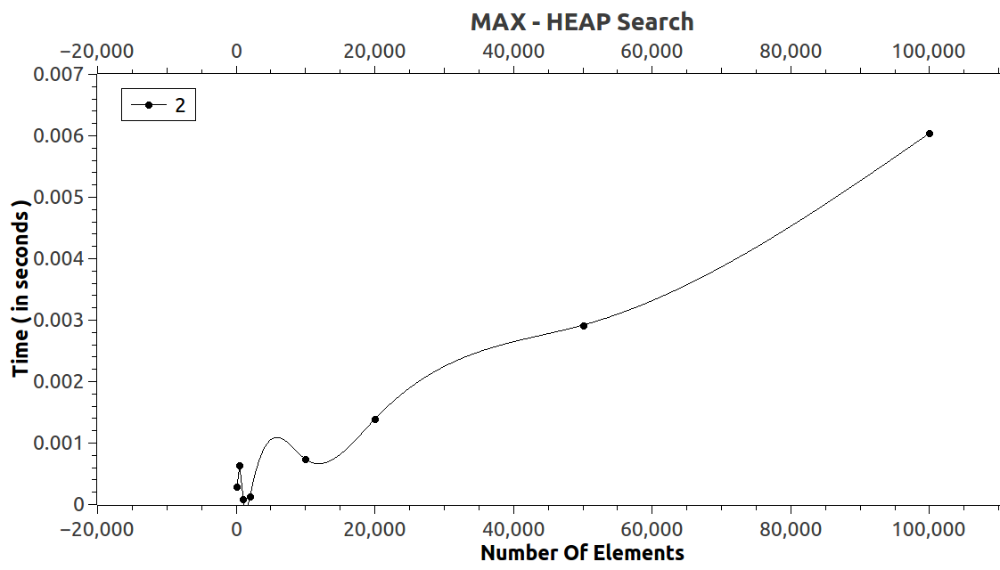
Graph Obtained :MAX - HEAP

Slide 39
OBSERVATION:
Since in the Worst case Time complexity of MAX
HEAP Insertion O(n) , and our graph approximately is
equivalent to a graph representing n function.
Plot for o(n)
Since our benchmark test was done
on a regular use PC,it might not get us
an accurate result.

Slide 40
DATA USED : MIN - HEAP
Number Of Inputs | Time ( in seconds )
100 | 0.0001029968261718
500 | 0.0000855922698974
1000 | 0.0000982284545898
2000 | 0.000274658203125
10000 | 0.0014498233795166
20000 | 0.0024225711822509
50000 | 0.0051190853118896
100000 | 0.0106301307678222

Slide 41
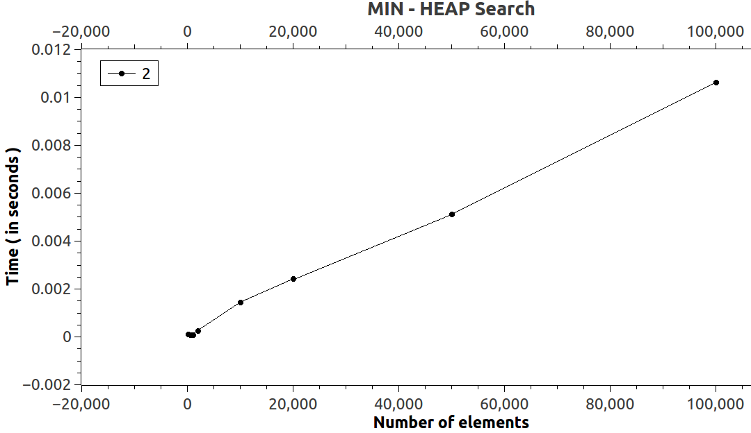
Graph Obtained :MIN - HEAP

Slide 42
OBSERVATION:
Since in the Worst case Time complexity of MIN
HEAP Insertion O(n) , and our graph approximately isequivalent to a graph representing n function.
Plot for o(n)
Since our benchmark test was done
on a regular use PC,it might not get us
an accurate result.

Slide 43
EXTRACTMAX ANALYSIS Of HEAPS
Used for max-heaps , returns the max value that is
root node.
Number Of Inputs | Time ( in seconds )
100 | 0.0000094814927188
500 | 0.0000177777988477
1000 | 0.0000327901623192
2000 | 0.0000150123634714
10000 | 0.0000169876744544
20000 | 0.0000375309086786
50000 | 0.0000229136074034
100000 | 0.0000410864684479
DATA USED :

Slide 44
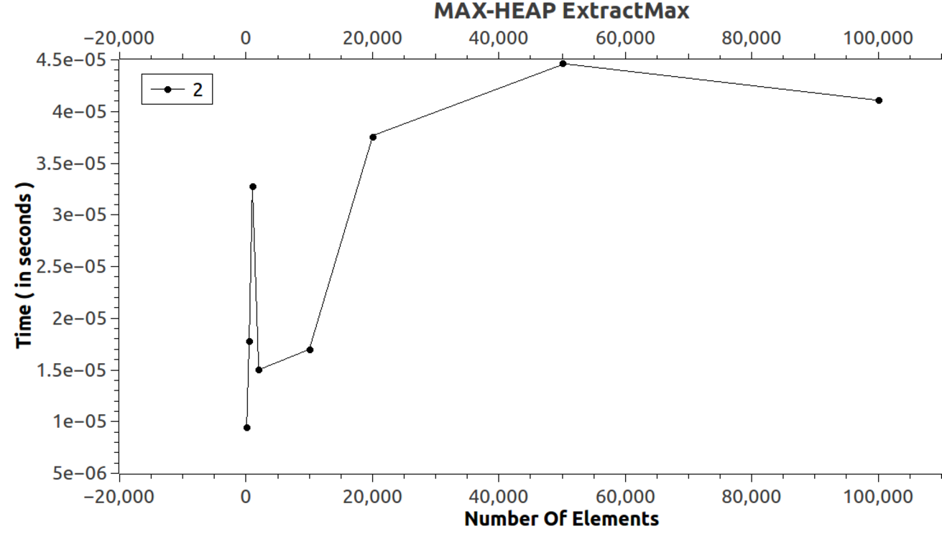
Graph Obtained :MAX - HEAP

Slide 45
OBSERVATION:
Asymptotic worst--case running time is in O(log n).
Plot for o(log n)
Since our benchmark test was done
on a regular use PC,it might not get us
an accurate result.

Slide 46
EXTRACTMIN ANALYSIS Of HEAPS
Used for min-heaps , returns the min value that is
root node.
Number Of Inputs | Time ( in seconds )
100 | 0.0000094814927188
500 | 0.0000323951001225
1000 | 0.0000126419902917
2000 | 0.0000138271768815
10000 | 0.0000138271768815
20000 | 0.0000169876744545
50000 | 0.0000244938561902
100000 | 0.0000347654733022
DATA USED :

Slide 47
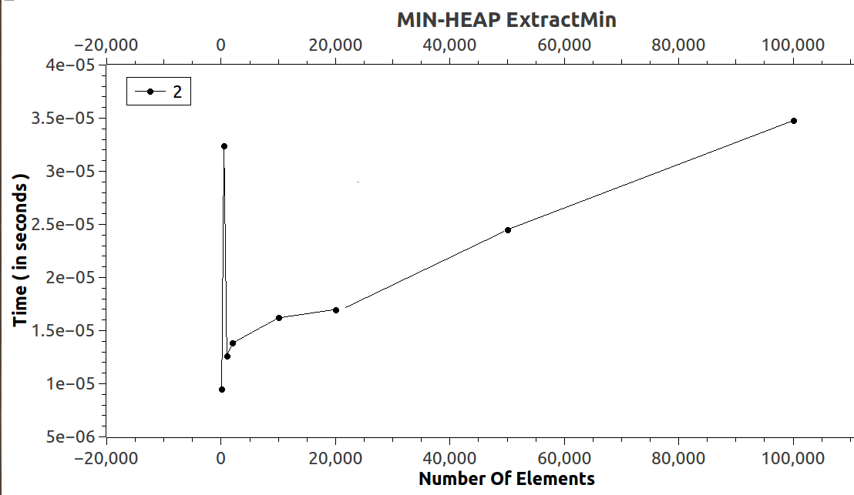
Graph Obtained :MIN - HEAP

Slide 48
OBSERVATION:
Asymptotic worst--case running time is in O(log n).
Plot for o(log n)
Since our benchmark test was done
on a regular use PC,it might not get us
an accurate result.

